Slide 1

A Project Synopsis Presentation on Vector Vigil Presented By: Deepesh Mishra (2000971540023) Shikhar Sharma (2000971540051) Shushant Sharma (2000971540053) Guided By: Ms. Arti Tiwari Department of Computer Science & Engineering Galgotias College of Engineering & Technology , Greater Noida Dr.A.P.J.AbdulKalam Technical University, Lucknow, Uttar Pradesh

Slide 2
Table of contents
Introduction
Literature Survey
Research Gap
Research Objectives
Problem Statement
Methodology
Proposed work
System design
Result and Conclusion
Reference

Slide 3
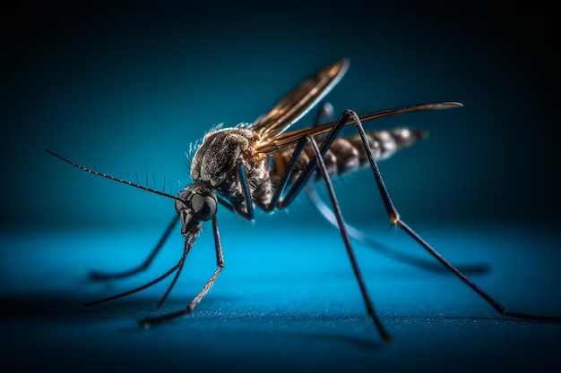
Introduction
In India, Vector-borne diseases are a major public health problem, affecting millions of people.
The spread of vector-borne diseases is influenced by a variety of factors, including climate, weather, and human behaviour.
This project aims to develop a time series model to predict the spread of vector-borne diseases using weather data.
The model will be trained on historical weather data and data on the occurrence of vector-borne diseases.
The model will then be used to predict the spread of vector-borne diseases in the future. It will work as a way of an alerting system.

Slide 4
Literature Survey
1
Ruiz Moreno Model (2012)[1]
Implemented by Ruiz Moreno and Sanches Varagas in 2012.
Used to predict the potential peaks of CHIKV in North America.
They used the Climate based data and the density of vector bodies with the initial data of infected people.
The relationship is calculated using multiple varaible mostly constant.
Constrained to only CHIKV and North America.

Slide 5
Literature Survey
2
Modified Ruiz Moreno Model (2016)[2]
Created under DARPA ‘Forecasting Chikungunya’ challenge in 2014.
Implemented by Kathryn Cooper, Robin Gandhi and more in 2016.
Used to predict the potential peaks of all vector borne diseases in the entire America.
They used the Climate based data and the density of vector bodies of diffrent life stages with the initial data of infected people.
The relationship is calculated using multiple varaible with less constant.

Slide 6
Literature Survey
3
PROVNA Project (2023)[3]
An Initiative to predict risk areas of vector borne diseases by WOAH.
It will use the earth observation data to predict the risky areas.
The new approach is to use more affecting factors like soil type, terrain areas, and migration of other affected animals.
The project is under development and will release the prototype model in the last quater of 2023.

Slide 7
Research Gap
The prediction of the spread of the vector borne diseases before its spreading is not been able to achieved yet. (Modified Ruiz Moreno Model)
There are multiple factors that are not considered in the previous models. (PROVNA Project)

Slide 8
Research Objectives
To identify the factors that influence the spread of vector-borne diseases.
Establishing Correlations between Weather Patterns and Vector-Borne Diseases.
Developing a Time Series Model for Disease Spreading Prediction.
Providing Actionable Insights for Public Health Interventions.

Slide 9
PROBLEM STATEMENT
How can we develop a time series model to predict the spread of vector-borne diseases using weather data?

Slide 10
Methodology
Data Collection
Obtain historical weather data and disease data.
Data of similar time period.
Exploratory Data Analysis
Undersatand trends, patterns and correlations.
Obtain a pattern.
Use graphs, heatmaps, etc.
Data Preprocessing
Clean and validate data.
Time Alignment.

Slide 11
Time Series Analysis
Select and create a model.
Train and test the model using the pattern obtained.
Predict the chances of risks.
Result Validation
Use the heatmaps for the visualization of result.
Heatmaps will show the chances of spreading of the disease.

Slide 12
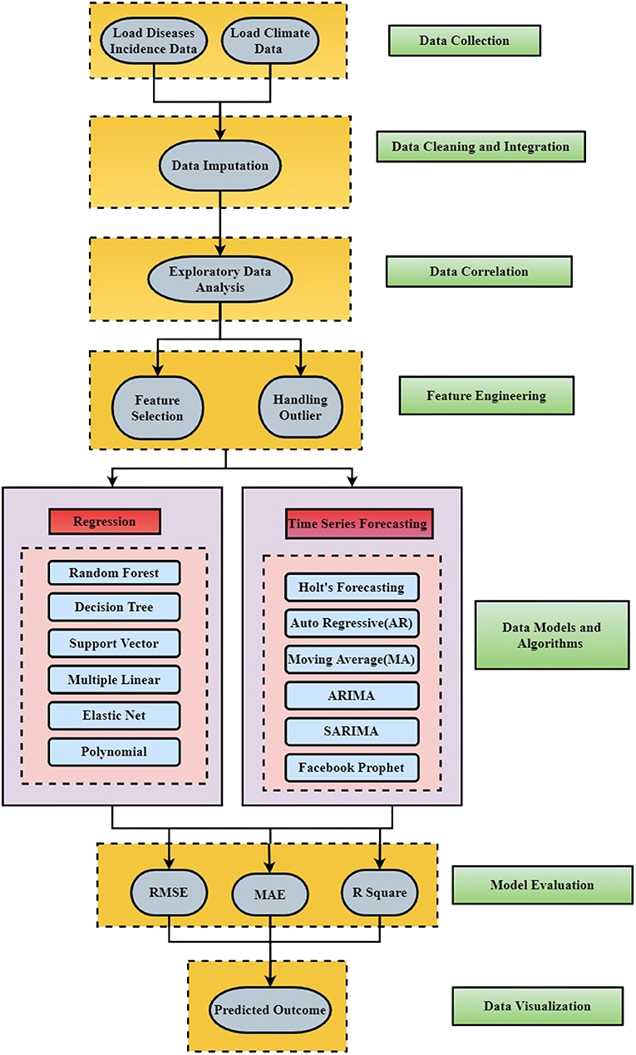
Proposed Work
Detailed workflow and layered architecture for constructing the dengue forecasting model.
The model approch can be divided in the following major steps:

Slide 13
Proposed Work
Data Collection
There was two types of the that was required :
Cimate data, obtained by Indian Metereological Department.
Disease data, obtained by NCVBDC.
The data obtained was from 2012 to 2020 of Mumbai City.

Slide 14
Proposed Work
Data Cleaning and Integration
Involves merging different datasets if necessary to create a unified and coherent dataset.
Aligning and combining data wth consist time duration.
Handling missing values, outliers, and inconsistencies in collected datasets.

Slide 15
Proposed Work
Exploratory Data Analysis
Utilize visualization and statistical techniques.
Understand variable distribution, identify trends, and recognize outliers.
Essential for making informed decisions about feature selection, model choice, and overall project strategy in the proposed work.
Outlier detection and feature selection are applied, to improve the data quality.

Slide 16
Proposed Work
Feature Engineering
Meteorological data consist of extreme values for specific periods, such as extreme wind speed, rainfall, and humidity. So outliners are used.
For determining the relevant features, two measures are calculated: redundancy and relevance.

Slide 17
Proposed Work
Model Used / Algorithm
Multiple Time Series Model are implemented like :
AR : Captures the linear relationship between an observation and its lagged values.
MA : Emphasizes the relationship between an observation and a residual error.
ARIMA : Handle non-stationary time series.
SARIMA : Extension of ARIMA with seasonal components to capture periodic patterns.
Facebook Prophet: Incorporates seasonality, holidays, and special events using an additive model.
Holt's Forecasting: Considers level and trend components to forecast future values.

Slide 18
Proposed Work
Model Evaluation
RMSE (Root Mean Squared Error):Measures the average magnitude of the residuals (prediction errors) by taking the square root of the average squared differences between predicted and actual values.
MAE (Mean Absolute Error): Computes the average absolute differences between predicted and actual values.
R-squared : Indicates the proportion of the variance in the dependent variable that is predictable from the independent variables. It ranges from 0 to 1, where a higher value signifies a better fit of the model to the data.

Slide 19
Proposed Work
Result and Visuaization:
Seasonal Trends: Maximum incidences occur between June and September, correlating with average rainfall between 150 and 350 mm.
Overall Pattern: Increase in humidity or rainfall corresponds to an increase in dengue cases Mumbai.
Predicted data will be displayed in the form of a heatmap.

Slide 20
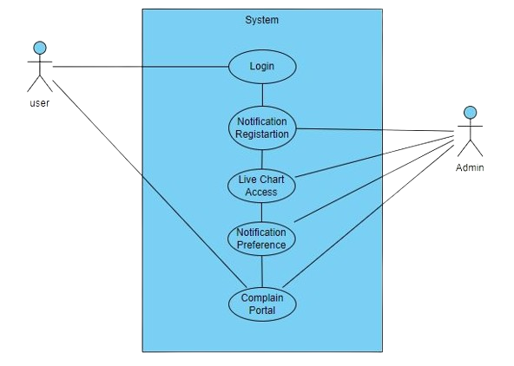
System Design
Types of Users:
Local Public: The local residents of the particular cities.
Funtionalities :
Can Visuailize the current state of the spread using heatmaps.
Provide information for the emergency message alert.
Can set preference in notification.

Slide 21
System Design
Types of Users:
Govt. Authority : People from the government surveillance department.
Funtionalities :
Can Visuailize the current state and predicted state of the spread using heatmaps.
Can inform the local authority of the severly affected areas.
Handles and monitor local areas.

Slide 22
Result and Conclusion
Project combines meteorological factors, data analytics, and advanced models for a holistic understanding.
Division into five regions provides nuanced insights into disease patterns, aiding targeted interventions.
Random Forest and Time Series models capture the intricacies of disease spread for robust predictions.
Meticulous enhancement ensures a high-quality dataset, crucial for discerning subtle patterns.
Findings contribute to disease prediction, public health planning, and offer a template for global proactive health strategies.

Slide 23
References
Ruiz-Moreno D, Vargas IS, Olson KE, Harrington LC (2012) Modeling Dynamic Introduction of Chikungunya Virus in the United States. PLoS Negl Trop Dis 6(11): e1918. https://doi.org/10.1371/journal.pntd.0001918.
Ewing, D. A., Purse, B. V., Cobbold, C. A., & White, S. M. (2021). A novel approach for predicting risk of vector-borne disease establishment in marginal temperate environments under climate change: West Nile virus in the UK. Journal of the Royal Society Interface, 18(178). https://doi.org/10.1098/rsif.2021.0049.
World Organization for Animal Health, (2022), Early-warning systems: modeling the spread of vector-borne diseases. https://www.woah.org/en/article/early-warning-systems-modeling-the-spread-of-vector-borne-diseases/.
Sadeghieh T, Waddell LA, Ng V, Hall A, Sargeant J. 2020. A scoping review ofimportation and predictive models related to vector-borne diseases, pathogens, reservoirs, or vectors (1999–2016). PLoS ONE 15, e0227678.
Kearney M, Porter W. 2009. Mechanistic niche modelling: combining physiological and spatial data to predict species’ ranges. Ecol. Lett. 12, 334-350.
Paz S. 2015. Climate change impacts on West Nile virus transmission in a global context. Phil. Trans. R. Soc. B 370, 1-11.
Estrada-Peña A, Ayllóon N, Fuente J de la. 2012. Impact of climate trends on tick- borne pathogen transmission. Front. Physiol. 3, 1-12.
Tjaden NB, Caminade C, Beierkuhnlein C, Thomas SM. 2018. Mosquito-borne diseases: advances in modelling climate-change impacts.
Rocklöv J, Dubrow R. 2020. Climate change: an enduring challenge for vector-borne disease prevention and control. Nat. Immunol. 21, 479-483.

Slide 24
Thank You?
Do you have any questions?

